Slide 1
Deployment

Slide 2
Topics to be covered
Getting Started
Terms and Concepts
Common Modeling Techniques

Slide 3
Introduction
A node is a physical element that exists at run time and represents a computational resource, generally having at least some memory and, often, processing capability.
We use nodes to model the topology of the hardware on which your system executes.
A node typically represents a processor or a device on which components may be deployed.

Slide 4
Getting Started
When we architect a software-intensive system, we have to consider both its logical and physical dimensions.
On the logical side, you’ll find things such as classes, interfaces, collaborations, interactions and state machines.
On the physical side you’ll find components and nodes.

Slide 5
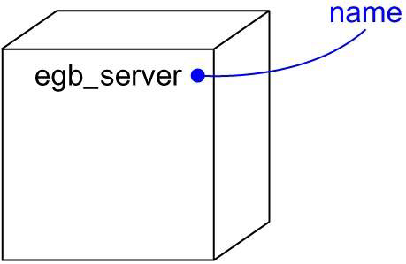
Getting Started
In UML, a node is represented as a cube as shown below figure.
This canonical notation permits you to visualize a node apart from any specific hardware.
Using stereotypes we can tailor this notation to represent specific kinds of processors and devices.

Slide 6
Terms and Concepts
A node is a physical element that exists at run time and represents a computational resource, generally having at least some memory and, often, processing capability.
Graphically, a node is rendered as a cube.

Slide 7
Names
Every node must have a name that distinguishes it from other nodes.
A name is a textual string.
That name alone is known as a simple name; a path name is the node name prefixed by the name of the package in which that node lives.
A node is typically drawn showing only its name, as shown in below figure.
Just as with classes, you may draw nodes adorned with tagged values or with additional compartments to expose their details.

Slide 8
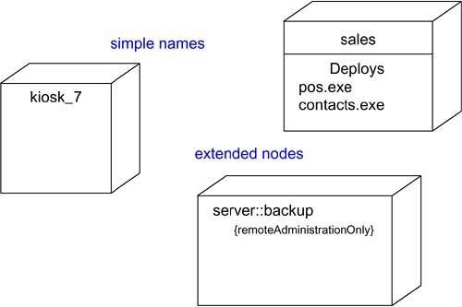
Names

Slide 9
Nodes and Components
In many ways, nodes are like components: Both have names, both may participate in dependency, generalization and association relationships, both may be nested, both may have instances, both may be participants in interactions.

Slide 10
Nodes and Components
However, there are significant differences between nodes and components:
  Components are things that participate in the execution of a system. Nodes are things that execute components.
  Components represent the physical packaging of logical elements, nodes represent the physical deployment of components.
This first difference is the most important. Simply put, nodes execute components; components are things that are executed by nodes.
The second difference suggests a relationship among classes, components, and nodes.

Slide 11
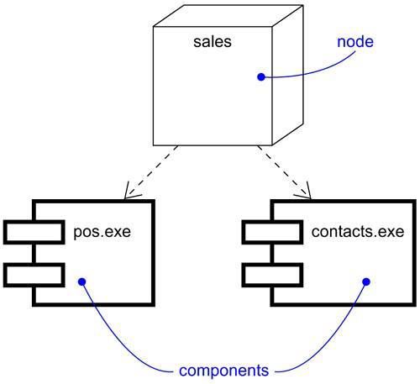
Nodes and Components
A set of objects or components that are allocated to a node as a group is called a distribution unit.

Slide 12
Organizing Nodes
We can organize nodes by grouping them in packages in the same manner in which you can organize classes and components.
We can also organize nodes by specifying dependency, generalization, and association (including aggregation) relationships among them.

Slide 13
Connections
The most common kind of relationship we’ll use among nodes is an association.
In this context, an association represents a physical connection among nodes, such as an Ethernet connection, a serial line, or a shared bus as shown in below figure.
We can even use associations to model indirect connections, such as a satellite link between distant processors.

Slide 14
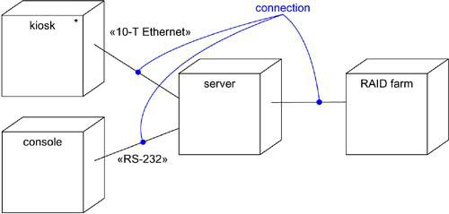
Connections

Slide 15
Common Modeling Techniques
There are two modeling techniques are there in Deployment:
Modeling Processors and Devices
Modeling the Distribution of Components

Slide 16
Modeling Processors and Devices
To model processors and devices:
Identify the computational elements of your system’s deployment view and model each as a node.
If these elements represent generic processors and devices, then stereotype them as such. If they are kinds of processors and devices that are part of the vocabulary of your domain, then specify an appropriate stereotype with an icon for each.
As with class modeling, consider the attributes and operations that might apply to each node.

Slide 17
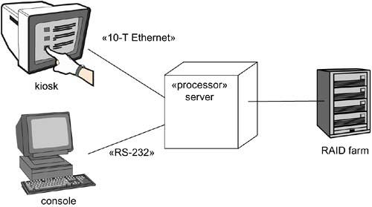
Modeling Processors and Devices

Slide 18
Modeling the Distribution of Components
To model the distribution of components:
For each significant component in your system, allocate it to a given code.
Consider duplicate locations for components.
Render this allocation in one of the three ways:

Slide 19
Modeling the Distribution of Components
Don’t make the allocation visible, but leave it as part of the backplane of your model that is, in each node’s specification.
Using dependency relationships, connect each node with the components it deploys.
List the components deployed on a node in an additional compartment.

Slide 20
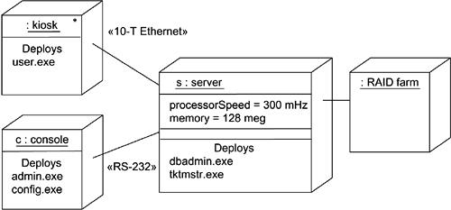
Modeling the Distribution of Components

